Slide 1
S E S S I O N 2 6
CLIP: Connecting Vision & Language
One model, two encoders, one shared space — how images and words learn to speak the same language
image → encoder → vector · “a photo of a dog” → encoder → vector
then compare with a single dot product
Theory + guided code walkthrough · ~1.5 hours · Computer Vision & AI Course

Slide 2
Session 26 · CLIP — Connecting Vision & Language
2
Today's Agenda
From “how do I label 8,000 images?” to a model that classifies things it has never been trained on
PART 1 · THE IDEA
PART 2 · BUILD FROM SCRATCH
PART 3 · USE THE REAL ONE
~25 min
~35 min
~30 min
The labelling problem CLIP solves
A shared space for images & text
The acronym, deconstructed
Contrastive learning & the N×N matrix
FLICKR-8K: images + captions
Image encoder, text encoder, projection head
The symmetric loss, line by line
Train, embed, and search by text
OpenAI CLIP: 400M pairs of supervision
Zero-shot classification, step by step
Code: ViT-B/32 in five lines
Where CLIP hides in tools you already use
Materials: slides + Session_26_CLIP_Practical.ipynb · based on Modern Computer Vision with PyTorch, Ch. 16

Slide 3
Session 26 · CLIP — Connecting Vision & Language
3
The Problem: Images Without Labels
A thought experiment from the book — and the exact situation CLIP was designed for
The setup: you have an image dataset with no labels attached to any image.
The one thing you do have: an exhaustive list of every unique label that appears somewhere in the dataset.
The question: how do you assign the most probable label to each image?
Classic classifiers can't help — they need (image, label) pairs to train on. We have images and labels, but no pairing.
CLIP's answer: embed both images and labels into the same vector space, then match each image to its nearest label.
IMAGES (no labels)
LABEL LIST
dog
?
cat
plane
horse
8,000 photos, zero annotations
⋮
which label goes with which image?

Slide 4
Session 26 · CLIP — Connecting Vision & Language
4
The Key Idea: One Space for Both
If images and text live as vectors in the same space, “which label fits?” becomes “which vector is closest?”
An embedding is just a list of numbers — a point in space — that captures what something means.
CLIP produces two kinds: one embedding per image, one per text (a class name or caption).
The trick: both are mapped into the same space, so an image vector and a text vector can be compared directly.
Similarity = dot product. Compute similarity between an image and every candidate label.
The label with the highest similarity to the image embedding is the most probable label. That's the whole inference recipe.
SHARED EMBEDDING SPACE
dog image
“dog”
close = same concept
“plane”
far = different concepts
plane image
Same colours as the paper's figure: green = image side, purple = text side

Slide 5
Session 26 · CLIP — Connecting Vision & Language
5
CLIP, Deconstructed
Contrastive Language-Image Pre-training — the book unpacks it back to front
P
Pre-training
The model is trained on a huge corpus of data — learning general-purpose representations before you ever point it at your task.
L-I
Language-Image
That corpus contains both images and the text that goes with them — for example, the alt-text attached to a web image. Two modalities, paired.
C
Contrastive
Training pushes matched image & text embeddings to be similar, while the embedding of one object and the text of another are made as dissimilar as possible.
Read bottom-up and you get the recipe: pre-train, on paired language + images, with a contrastive objective.

Slide 6
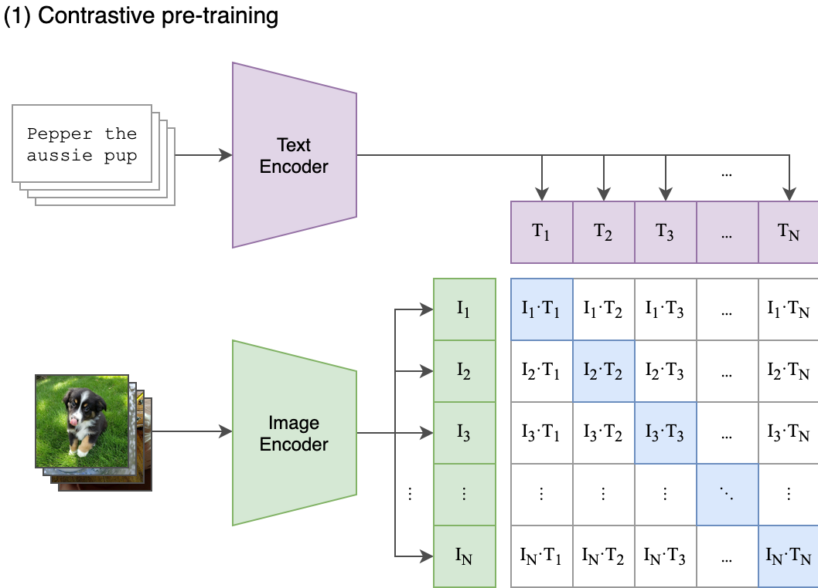
Session 26 · CLIP — Connecting Vision & Language
6
Contrastive Pre-training, In One Picture
The diagram from the paper — every element here will reappear in our code
A batch of N pairs. “Pepper the aussie pup” goes through the Text Encoder; its photo goes through the Image Encoder.
Out come N text embeddings T₁…Tₙ and N image embeddings I₁…Iₙ.
The N×N grid holds every pairwise dot product Iᵢ·Tⱼ — image i scored against text j.
The diagonal cells (highlighted blue) are the true pairs. Training makes those scores high and everything off-diagonal low.
Figure: Radford et al., “Learning Transferable Visual Models From Natural Language Supervision”, OpenAI 2021

Slide 7
Session 26 · CLIP — Connecting Vision & Language
7
The N×N Game: Pull Diagonal, Push the Rest
One batch gives N correct pairs — and N²−N free negative examples
Each row is a classification problem: for image i, which of the N captions is mine? The answer is caption i.
Each column too: for caption j, which of the N images is mine? Symmetric in both directions.
No human labelling needed — the pairing itself is the supervision. Alt-text on the web comes for free.
This is why it scales: bigger batches mean more negatives per step, and any (image, text) pair found online is training data.
similarity(i, j) = Iᵢ · Tⱼ
T1
T2
T3
T4
I1
↑
↓
↓
↓
I2
↓
↑
↓
↓
I3
↓
↓
↑
↓
I4
↓
↓
↓
↑
↑ diagonal: matched pair — maximise similarity ↓ off-diagonal: mismatched — minimise it

Slide 8
Session 26 · CLIP — Connecting Vision & Language
8
Our Build: Three Components
The architecture we'll assemble from scratch — exactly as in the book's Chapter 16 code
ImageEncoder
TextEncoder
ProjectionHead × 2
ResNet-50 (pre-trained, via timm)
DistilBERT (pre-trained)
Linear → GELU → FC → Dropout → +residual → LayerNorm
Turns any image into a 2048-d feature vector. global_pool="avg", classifier head removed (num_classes=0).
Tokenized caption → hidden states; we keep the CLS token (index 0) as the sentence's 768-d embedding.
Maps 2048-d (image) and 768-d (text) into one shared 256-d space so they can be compared.
SHARED 256-D SPACE both embeddings are now the same size — ready for the dot product

Slide 9
Session 26 · CLIP — Connecting Vision & Language
9
Why the Projection Head Matters
2048-d and 768-d vectors can't be dot-producted — someone has to build the bridge
The mismatch: ResNet-50 speaks 2048 numbers per image; DistilBERT speaks 768 per sentence. Different lengths — no comparison possible.
The fix: a small learned MLP on each side projects both into the same 256-d space.
Residual + LayerNorm keep training stable: the projected vector is added back to itself (x = x + projected) and normalised.
These heads are where alignment lives. The encoders extract meaning; the heads learn to line the two modalities up.
Linear(embedding_dim → 256)
GELU
FC(256 → 256)
Dropout
x = x + projected (residual)
LayerNorm(256)

Slide 10
Session 26 · CLIP — Connecting Vision & Language
10
The Loss: Symmetric Cross-Entropy
Read CLIPModel.forward top to bottom — this is the heart of the whole model
CLIPMODEL.FORWARD — THE CORE LINES
logits is our N×N matrix from the figure.
Soft targets: instead of a hard identity matrix, the book uses intra-modal similarity — two near-identical photos shouldn't be forced apart.
temperature scales the logits before softmax: it controls how sharp or forgiving the distribution is.
Symmetric: average of row-wise and column-wise loss — both matching directions matter equally.
# similarity of every text to every image
logits = (text_emb @ image_emb.T) / temperature
# how similar images are to each other (and texts)
images_similarity = image_emb @ image_emb.T
texts_similarity = text_emb @ text_emb.T
targets = F.softmax((images_similarity +
texts_similarity) / 2*temperature, dim=-1)
# both directions: texts→images and images→texts
texts_loss = cross_entropy(logits, targets)
images_loss = cross_entropy(logits.T, targets.T)
loss = (images_loss + texts_loss) / 2.0
Output is returned as {“loss”: loss} — a dictionary, to stay compatible with the Hugging Face Trainer.

Slide 11
Session 26 · CLIP — Connecting Vision & Language
11
Building CLIP From Scratch: The Plan
Dataset: FLICKR-8K — chosen because it has both images and their captions
8,000
× 5
= 40k
~1 GB
photos from Flickr
captions per image
(image, text) pairs
download via Kaggle
Download
FLICKR-8K
CLIPDataset
tokenize + transform
Build model
2 encoders + heads
Train
HF Trainer, 1 epoch
Embed all
images
Search by
text query
Code: CLIP_from_scratch.ipynb, Chapter16 of the book's repo (bit.ly/mcvp-2e) — we work through the same steps in today's notebook. You'll need a Kaggle account for the dataset download.

Slide 12
Session 26 · CLIP — Connecting Vision & Language
12
CLIPDataset: Pairing Pixels With Tokens
Every __getitem__ returns one image and one tokenized caption — a ready-made pair
Captions CSV: image_filenames and captions must line up — 5 captions per image means each filename appears 5 times.
Text side: all captions tokenized up front with the DistilBert tokenizer (padding, truncation, max_length).
Image side: read → resize to a fixed size → normalise, via get_transforms(config).
Split: train_test_split(config) gives trn_ds and val_ds.
DATASET.PY — ESSENTIALS
class CLIPDataset(Dataset):
def __init__(self, df, config, mode):
self.tokenizer = DistilBertTokenizer\
.from_pretrained(...)
self.encoded_captions = self.tokenizer(
self.captions, padding=True,
truncation=True,
max_length=config.max_length)
def __getitem__(self, idx):
item = {k: torch.tensor(v[idx]) for k, v
in self.encoded_captions.items()}
image = read(f"{image_path}/{fname}")
item["image"] = transform(image)
item["caption"] = self.captions[idx]
return item

Slide 13
Session 26 · CLIP — Connecting Vision & Language
13
Training With the Hugging Face Trainer
Different parts of the model learn at different speeds — then the Trainer does the bookkeeping
Three parameter groups, three LRs: image encoder, text encoder (both pre-trained — small nudges), and the projection heads (fresh — learn faster, head_lr).
AdamW + weight decay, with ReduceLROnPlateau easing the LR down when validation loss stalls.
The Trainer wraps opt.zero_grad(), loss.backward(), evaluation and checkpointing — same pattern you saw with detectron and mmaction.
Config for today: epochs=1, logging every 50 steps, metric_for_best_model="loss".
OPTIMIZER + TRAINER
params = [
{"params": image_encoder.parameters(),
"lr": config.image_encoder_lr},
{"params": text_encoder.parameters(),
"lr": config.text_encoder_lr},
{"params": chain(projection_heads),
"lr": config.head_lr, ...}]
optimizer = torch.optim.AdamW(params, ...)
trainer = Trainer(model=model,
args=training_args,
train_dataset=trn_ds,
eval_dataset=val_ds,
optimizers=(optimizer, lr_scheduler))
trainer.train()

Slide 14
Session 26 · CLIP — Connecting Vision & Language
14
The Payoff: Search Images With a Sentence
find_matches(…, query=“dogs on the grass”, n=9) — no dog label exists anywhere in training
Offline, once: run every image through the trained image encoder + projection → a bank of image embeddings.
At query time: tokenize and encode the query text with the text encoder + projection.
Normalise both, then one matrix multiply scores the query against every image at once.
torch.topk returns the n best matches — plot them and you get a grid of dogs on grass.
This is semantic search: the model matched meaning, not keywords or labels.
FIND_MATCHES — ESSENTIALS
batch = tokenizer([query])
text_features = model.text_encoder(
input_ids=..., attention_mask=...)
text_emb = model.text_projection(
text_features)
image_emb_n = F.normalize(image_embeddings)
text_emb_n = F.normalize(text_emb)
dot_similarity = \
text_emb_n @ image_emb_n.T
values, indices = torch.topk(
dot_similarity.squeeze(0), n)
# → show valid_df images at indices

Slide 15
Session 26 · CLIP — Connecting Vision & Language
15
Our CLIP vs. OpenAI's CLIP
The recipe is identical — the difference is three orders of magnitude of data and compute
OURS (today, from scratch)
OPENAI CLIP (pre-trained)
Training pairs
40k (FLICKR-8K)
400,000,000 (web-scale)
Image encoder
ResNet-50
ViT-B/32 (Vision Transformer)
Text encoder
DistilBERT
Transformer trained from scratch
Training budget
1 epoch, one GPU, minutes
Hundreds of GPUs, weeks
What it can do
search within FLICKR-8K
zero-shot classify almost anything
Takeaway from the book: training CLIP from scratch takes considerable compute and data — so in practice, we leverage OpenAI's pre-trained CLIP.

Slide 16
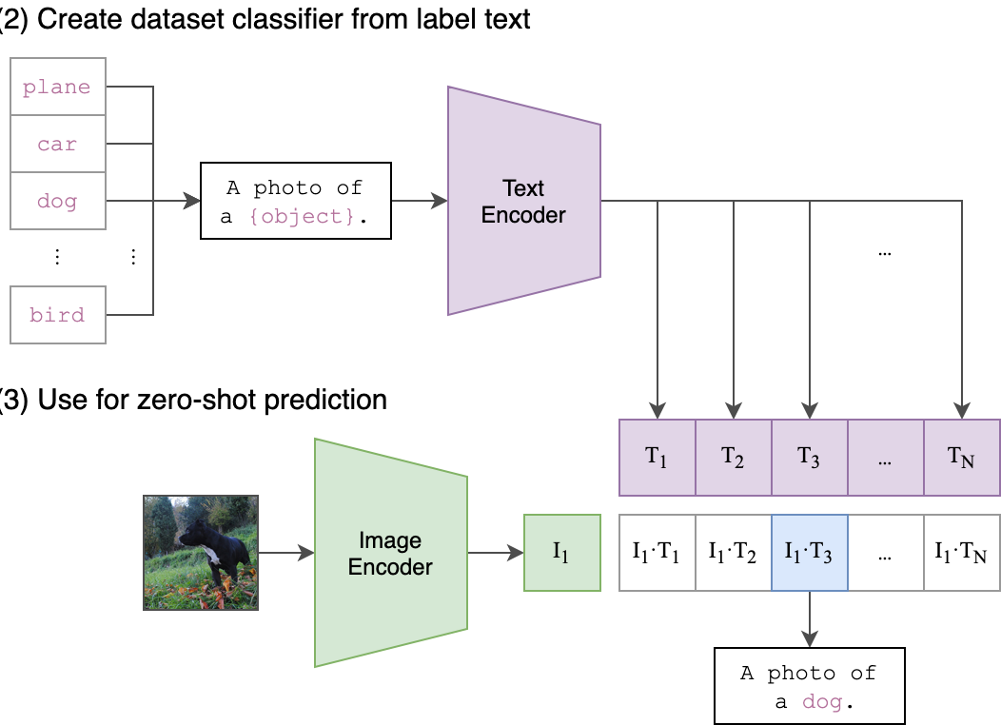
Session 26 · CLIP — Connecting Vision & Language
16
Zero-Shot Classification: A Classifier From Thin Air
Build a classifier for any label set — without a single training example
Step 2 — make the classifier: wrap each candidate label in a prompt — “A photo of a {object}.” — and encode all of them with the text encoder.
Step 3 — predict: encode the query image, dot it against every label embedding, softmax over the scores.
Highest similarity wins: here the image lands on T₃ → “A photo of a dog.”
“Zero-shot” because the model saw zero examples of these classes at training time — the label list can change at will.
Figure: Radford et al., OpenAI 2021 — panels (2) and (3)

Slide 17
Session 26 · CLIP — Connecting Vision & Language
17
OpenAI CLIP in Five Steps
OpenAI_CLIP.ipynb — the entire zero-shot pipeline fits on one slide
ZERO-SHOT WITH VIT-B/32
THE OUTPUT
# 1. install + clone
!pip install ftfy regex tqdm
!git clone https://github.com/openai/CLIP.git
# 2. load the pre-trained model
model, preprocess = clip.load("ViT-B/32",
device=device)
# 3. image + candidate labels
image = preprocess(Image.open("CLIP.png"))\
.unsqueeze(0).to(device)
text = clip.tokenize(["a diagram",
"a dog", "a cat"]).to(device)
# 4. one forward pass, 5. softmax
logits_per_image, _ = model(image, text)
probs = logits_per_image.softmax(dim=-1)
Label probs: a diagram 0.9928 a dog 0.0042 a cat 0.0030
We fed it the CLIP figure itself — and it says “a diagram” with 99.3% confidence.
Change the label list, get a new classifier. No retraining, ever.

Slide 18
Session 26 · CLIP — Connecting Vision & Language
18
You've Been Using CLIP All Along
One embedding space, many jobs — CLIP is infrastructure now
1
Stable Diffusion (Session 25)
2
Semantic image search
The 77×768 prompt embeddings that steer every denoising step? That's CLIP's text encoder. You met CLIP before you knew its name.
Google Photos-style “show me beach sunsets” — embed the query, embed the library, nearest neighbours win. You built this today.
3
Zero-shot classification
4
Open-vocabulary segmentation
Ship a classifier where labels change weekly (content moderation, retail catalogues) without collecting a single training set.
Next in the book: give a label, get the mask for just that object — CLIP-style text embeddings meet segmentation.

Slide 19
19
What You Now Know
From an unlabelled pile of images to a model that classifies anything you can name
THE ARC OF TODAY
The idea: embed images and text in one shared space; matching becomes a dot product, and web-scale alt-text becomes free supervision.
From scratch: ResNet-50 + DistilBERT + two projection heads, trained on FLICKR-8K with a symmetric contrastive loss — then text-driven image search with find_matches.
Pre-trained: OpenAI CLIP (400M pairs, ViT-B/32) turns any label list into a zero-shot classifier via “A photo of a {object}”.
Vocabulary you now own: contrastive learning, embedding space, projection head, temperature, zero-shot, semantic search.
NEXT SESSION From labels to masks — segmenting exactly the object you name (open-vocabulary segmentation & SAM)

Slide 20
Session 26 · CLIP — Connecting Vision & Language
20
Now: Open the Notebook
Session_26_CLIP_Practical.ipynb — we run everything you just saw
A
Warm-up: embeddings & similarity
Cosine similarity by hand on toy vectors — feel the dot product before trusting it with 40k pairs.
B
CLIP from scratch on FLICKR-8K
Dataset → encoders → projection heads → symmetric loss → HF Trainer → find_matches(“dogs on the grass”). Kaggle account needed.
C
Zero-shot with OpenAI CLIP
Load ViT-B/32, classify with prompts, build a mini semantic search over your own images, and probe its limits.
Tip: Part B trains for one epoch only — start the cell, and while it runs we'll talk through the loss again.

